Slide 1
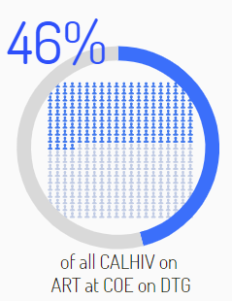
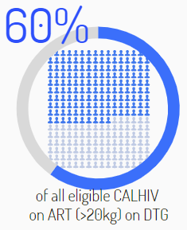
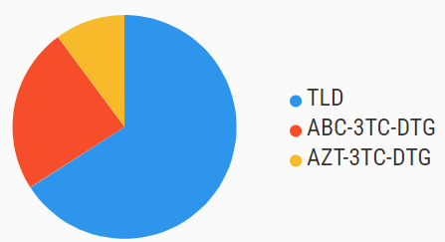
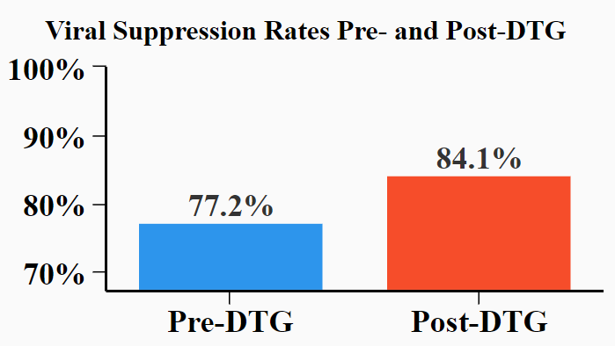
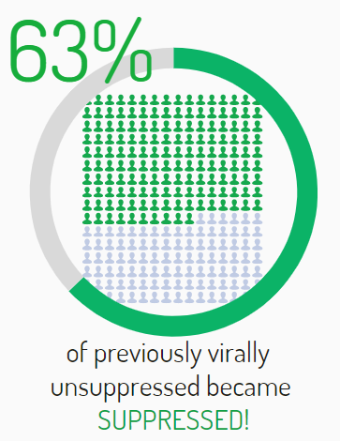
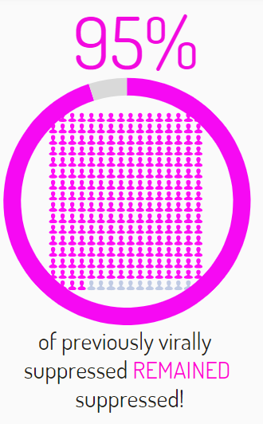
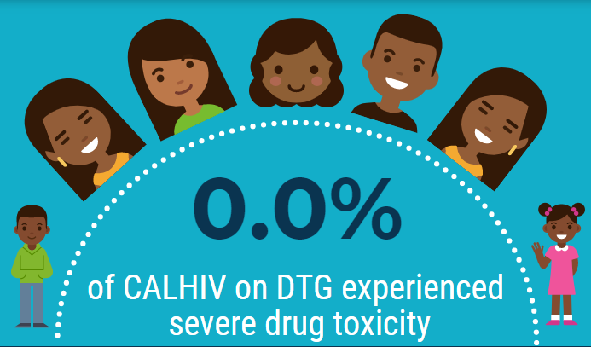
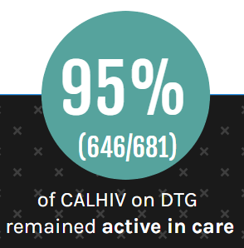
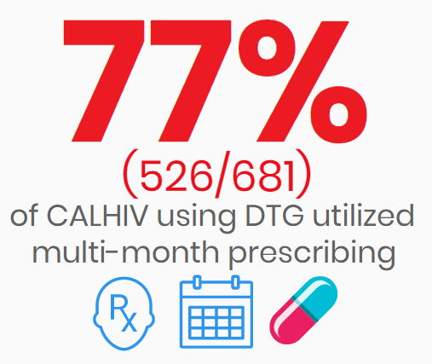
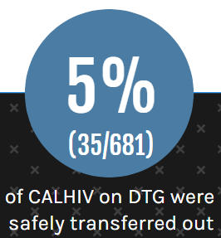
The “DTGs” of DTG for children and adolescents living with HIV (CALHIV):
Descriptions, Trends, and Gaps of rolling out dolutegravir in CALHIV in Mbeya, Tanzania
Jason M. Bacha^{1,2,3}, Benson Mayalla³, Nadiya Jiwa³, L. Mwita³, Liane R. Campbell^{1,2,3}
¹Baylor International Pediatric AIDS Initiative (BIPAI) at Texas Children’s Hospital, Baylor College of Medicine, Houston, TX, USA; ²Baylor College of Medicine, Houston, TX, USA; ³Baylor College of Medicine Children's Foundation - Tanzania, Pediatrics, Mbeya, Tanzania
Background:
In 2019, Tanzania procured dolutegravir (DTG) and began a country-wide rollout of DTG including new antiretroviral therapy (ART) initiations and shifting existing ART patients to DTG regimens.
We describe characteristics and outcomes of this DTG rollout for children and adolescents living with HIV (CALHIV) treated in Mbeya, Tanzania.
Results:
681 CALHIV received DTG at the Mbeya COE in 2019
Conclusion:
DTG was well tolerated and effective in our clinically diverse cohort of CALHIV
DTG use resulted in viral suppression for many previously unsuppressed CALHIV.
These results encourage continued use and scale up of DTG among eligible CALHIV.
66.0%
(449/681)
10.1%
(69/681)
(681/1497)
(681/1142)
23.9%
(163/681)
Baseline characteristics of our CALHIV on DTG cohort
Female | 50.0% (341/681)
Average age | 13.9 years (range 5.0-19.9 years)
Time on ART (average) | 5.4 years (range 0.0-14.4 years)
WHO Stage (baseline) WHO Stage I WHO Stage II WHO Stage III WHO Stage IV | 16.6% (113/681) 16.3% (111/681) 26.7% (182/681) 40.4% (275/681)
WHO Treatment Stage I | 97.8% (624/638)
Nutrition Status by BMI Severe malnutrition Moderate malnutrition Normal nutrition | 22.9% (156/681) 37.9% (258/681) 39.2% (267/681)
ART status New ART initiations Shifted from NNRTI regimen Shifted from PI regimen | 12.6% (86/681) 62.4% (425/681) 25.0% (170/681)
Materials and Methods:
Retrospective chart review was conducted to describe characteristics and outcomes of CALHIV who received DTG as part of their ART
Site: Baylor College of Medicine Children’s Foundation – Tanzania Centre of Excellence (COE) in Mbeya, Tanzania
Cohort: CALHIV on ART in care at the Baylor Tanzania COE in Mbeya.
Dates of analysis: 1 March 2019 (when DTG became available) through 31 December 2019.
HIV viral load (VL) suppression was defined as VL<1000 copies/mL
(499/593)
(448/589)
(42/66)
(48/51)
PRESENTED AT THE 23RD INTERNATIONAL AIDS CONFERENCE (AIDS 2020) | 6-10 JULY 2020

